Slide 1
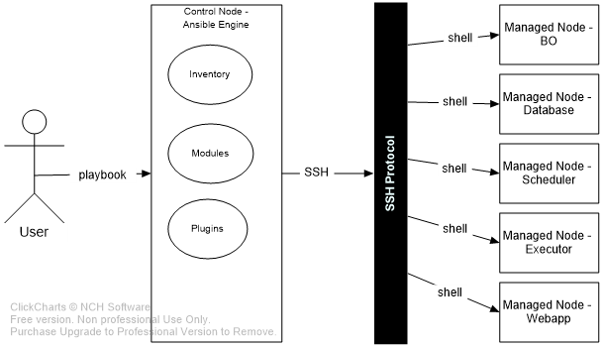
Ansible architecture
As you can see, in the diagram below, the Ansible engine has a direct interaction with the users who write playbooks to execute the Ansible engine. It also interacts with managed node through by SSH protocol.

Slide 2
Ansible architecture
The Ansible Automation engine consists of:
Inventories: Ansible inventories are lists of hosts (nodes) along with their IP addresses, servers, databases etc. which needs to be managed.
Modules: Modules are executed directly on remote hosts through playbooks. The modules can control system resources, like services, packages, or files (anything really), or execute system commands.
Plugins: Plugins allows to execute Ansible tasks as a job build step. Plugins are pieces of code that augment Ansible’s core functionality. Ansible ships with a number of handy plugins, and you can easily write your own. For example,
Cache plugins are used to keep a cache of ‘facts’ to avoid costly fact-gathering operations.
Callback plugins enable you to hook into Ansible events for display or logging purposes.
There are a few more components in Ansible Architecture which are explained below:
Hosts: The hosts in the Ansible architecture are just node systems which are getting automated by Ansible. It can be any kind of machine – Windows, Linux, RedHat etc.
Playbooks: Playbooks are simple files written in YAML format which describes the tasks to be executed by Ansible.

Slide 3
Ansible Setup
Download the RPM of Ansible engine from releases.ansible.com # curl -O https://releases.ansible.com/ansible/rpm/release/epel-7-x86_64/ansible-2.9.5-1.el7.ans.noarch.rpm
Install the PRM of Ansible engine
# yum localinstall ansible-2.9.5-1.el7.ans.noarch.rpm
Install the required libraries on the Ansible Control node
# yum install -y net-tools iproute zip unzip openssh-clients
Install the required libraries on the Ansible Managed nodes
# yum install -y net-tools iproute zip unzip openssh-server
Enable the sshd service on the Ansible Managed nodes
# systemctl enable sshd.service && systemctl start sshd.service

Slide 4
Ansible Setup
Make an inventory file on the Ansible Control node Add a ~/ansible_hosts file to test network connectivity. Here are a few examples:
Log in with password db.local ansible_host=172.17.0.3 ansible_port=22 ansible_user=root ansible_password=123456
Log in with private key db.local ansible_host=172.17.0.3 ansible_port=22 ansible_user=root ansible_ssh_private_key_file=nonprod-nfe-key-pair.pem
Log in with password and need to sudo user db.local ansible_host=172.17.0.3 ansible_port=22 ansible_user=ec2-user ansible_password=123456 ansible_become=true ansible_become_method=sudo ansible_become_user=oracle ansible_become_flags=-i
Log in with private key and need to sudo user db.local ansible_host=172.17.0.3 ansible_port=22 ansible_user=ec2-user ansible_ssh_private_key_file=nonprod-nfe-key-pair.pem ansible_become=true ansible_become_method=sudo ansible_become_user=oracle ansible_become_flags=-i

Slide 5
Ansible Setup
Test ansible on the Ansible Control node Run the ansible commnd as following: # ansible -i ~/ansible_hosts all -m ping You should see output for each host in your inventory, similar to this: db.local | SUCCESS => {"ansible_facts": { "discovered_interpreter_python": "/usr/bin/python"},"changed": false,"ping": "pong"}

Slide 6
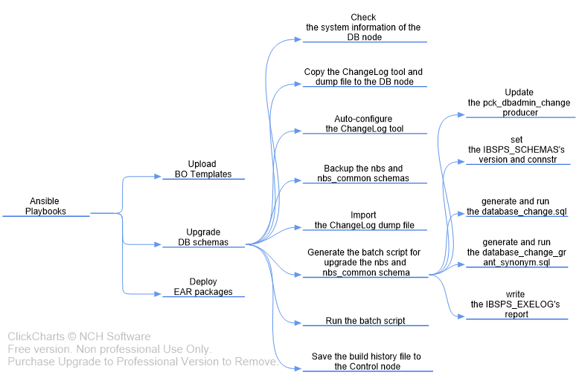
Ansible Playbook – database.yml

Slide 7
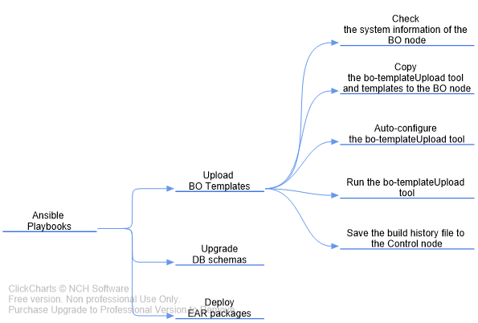
Ansible Playbook – bo.yml

Slide 8
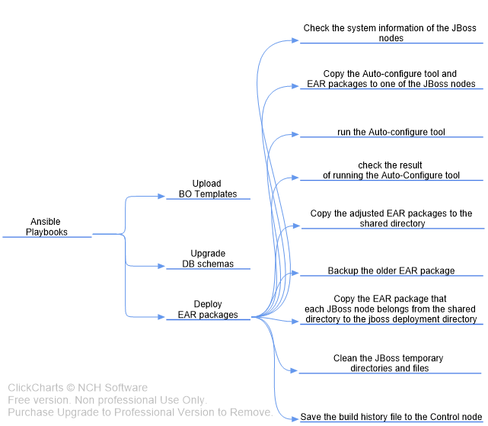
Ansible Playbook – jboss_deploy.yml

